Slide 1
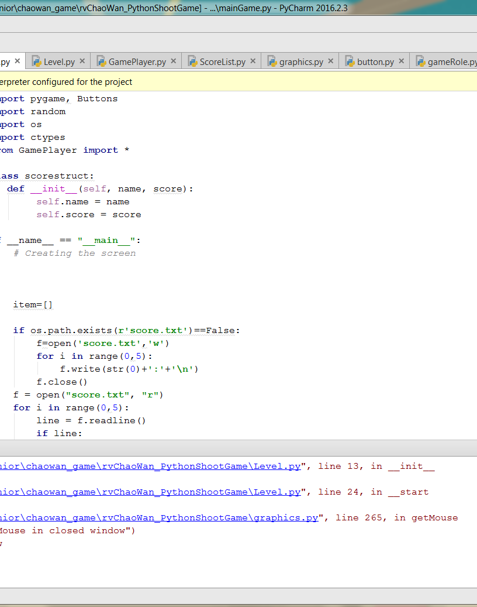
Senior Project Checkpoint III
By Chao Wan

Slide 2
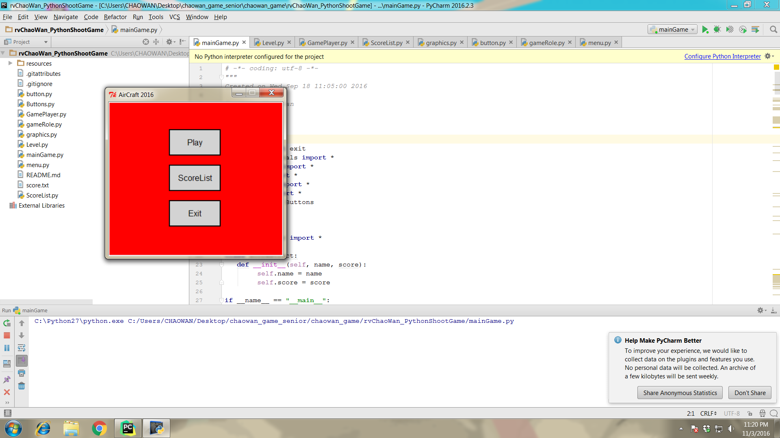
Main Menu

Slide 3
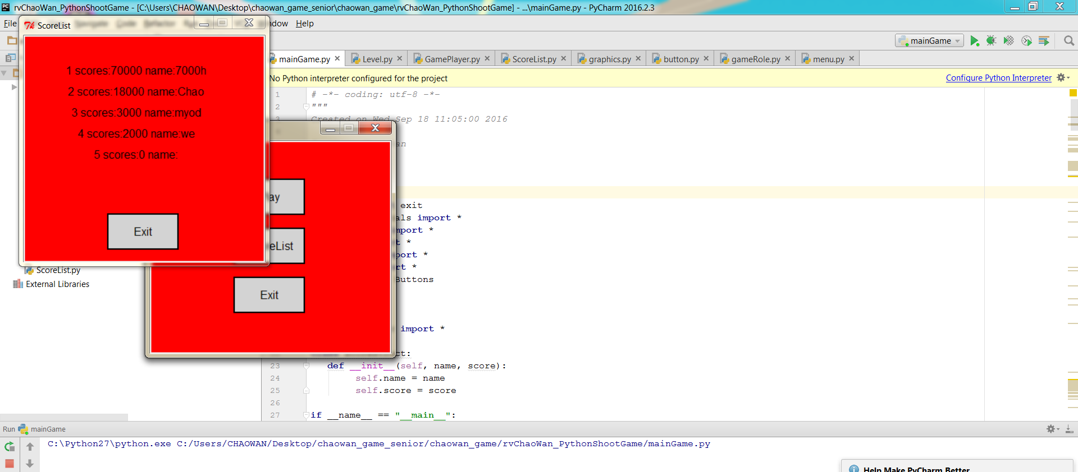
ScoreList: Ranking of Players

Slide 4
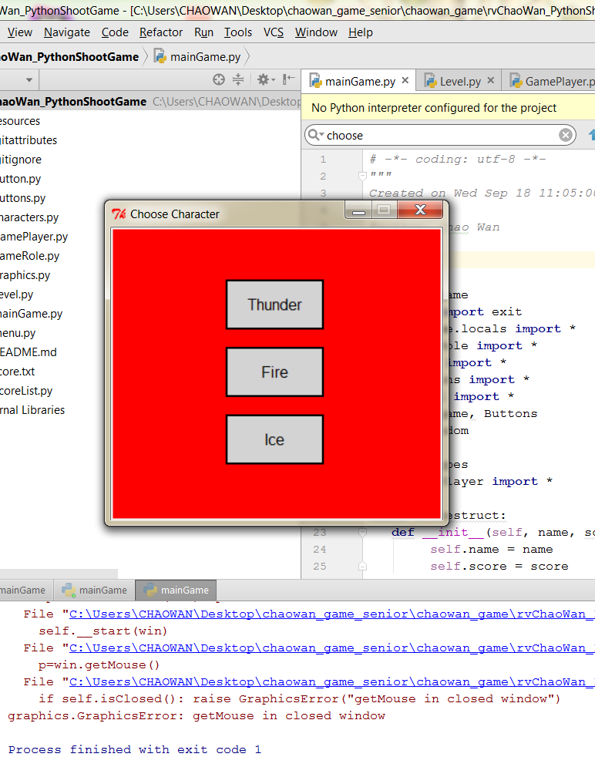
Choose a Character First

Slide 5
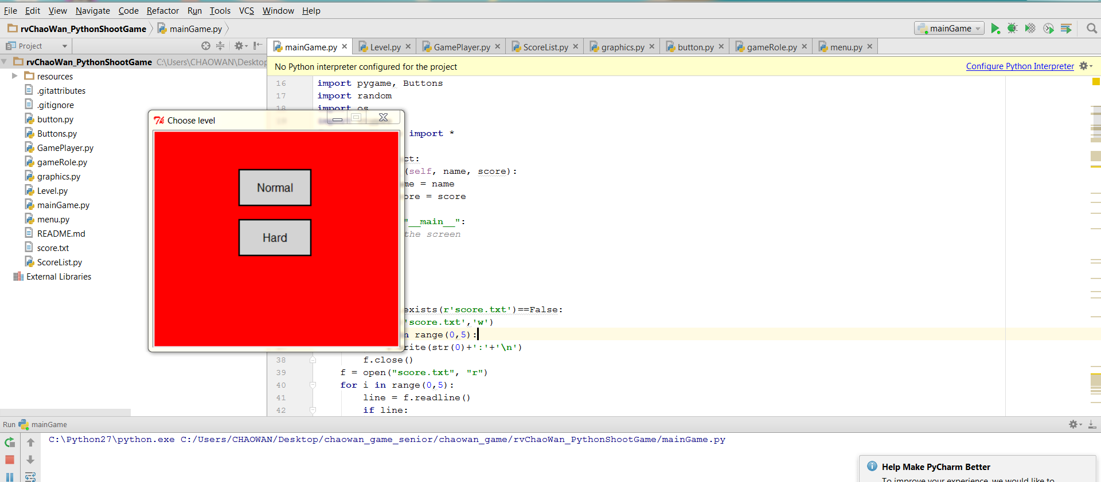
Challenge Level

Slide 6
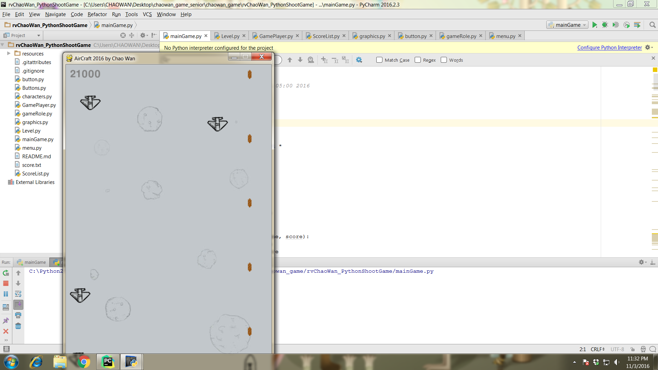
Main Game

Slide 7
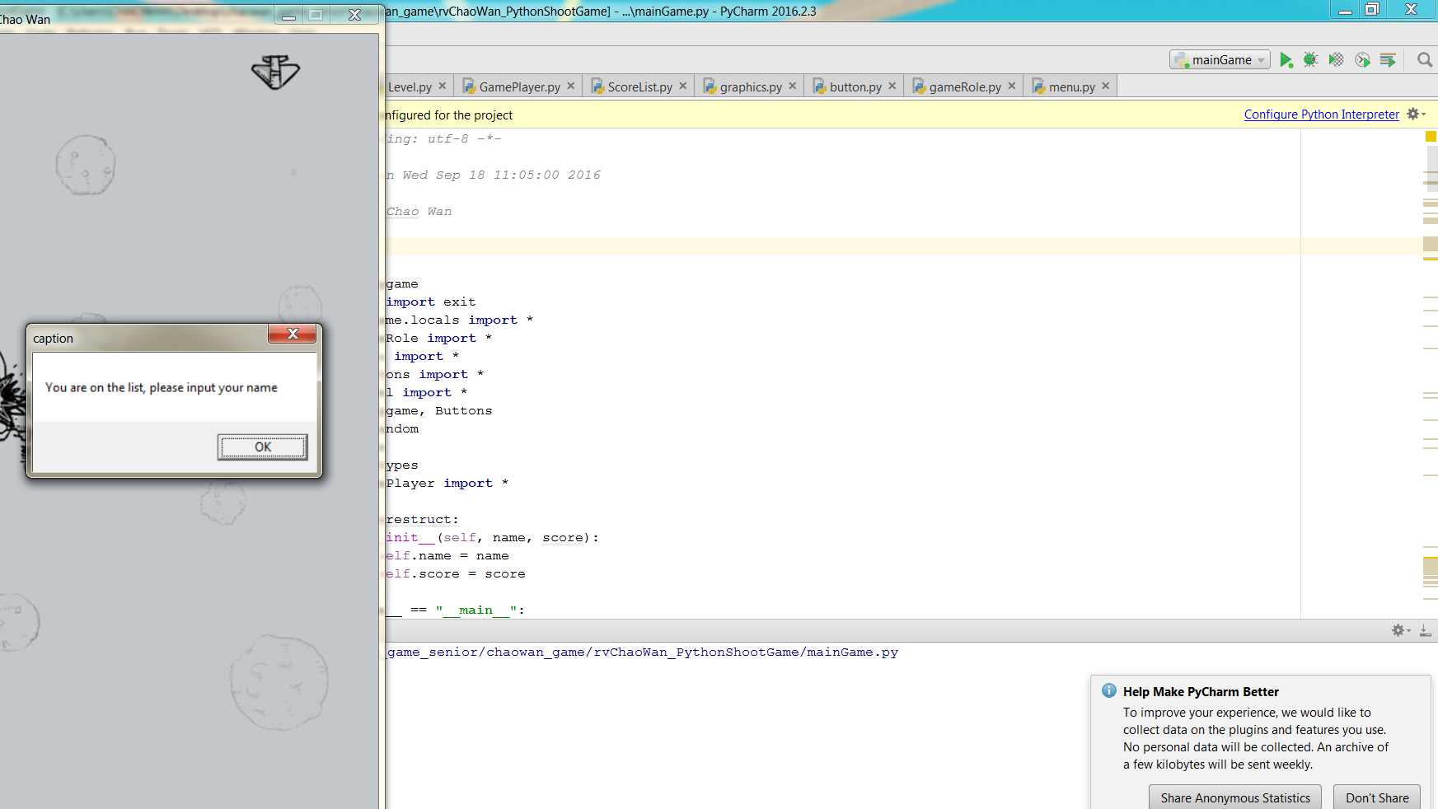
Get A Good Score?

Slide 8
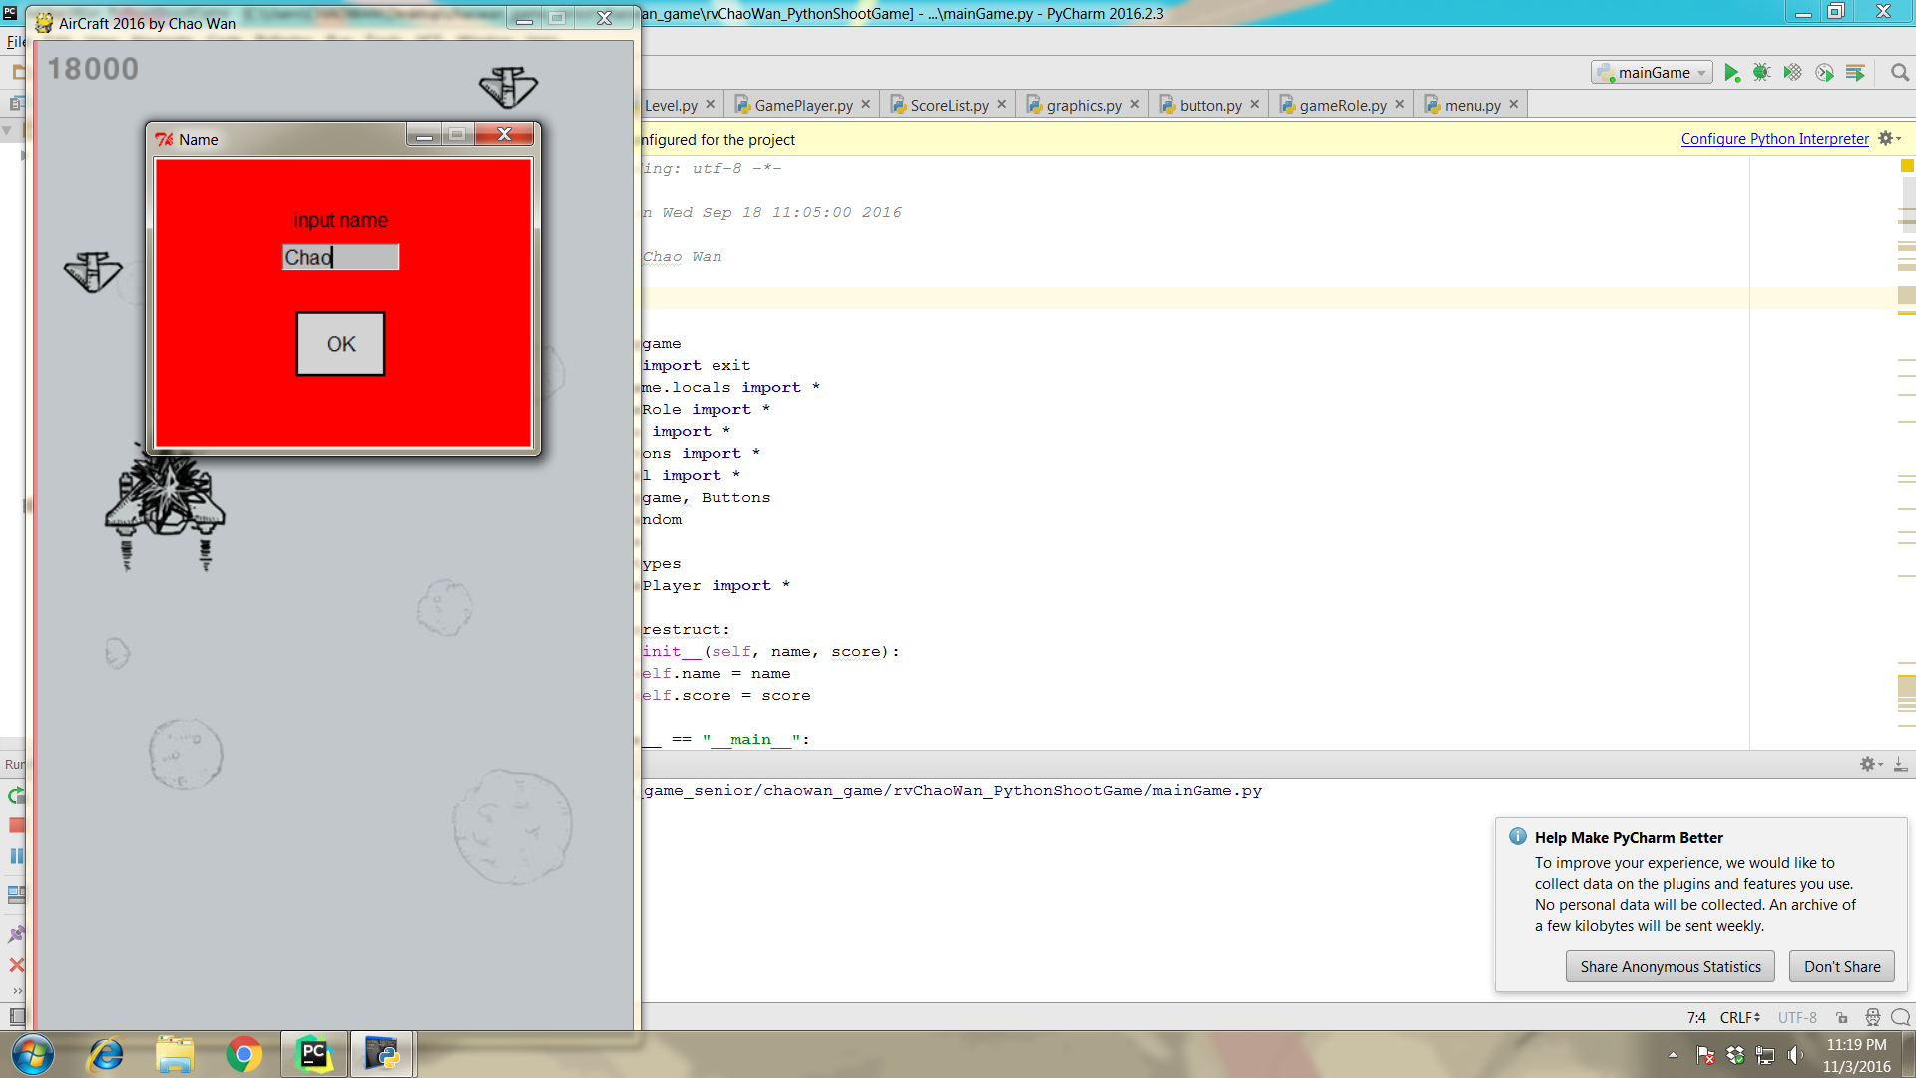
Your Name on the List

Slide 9
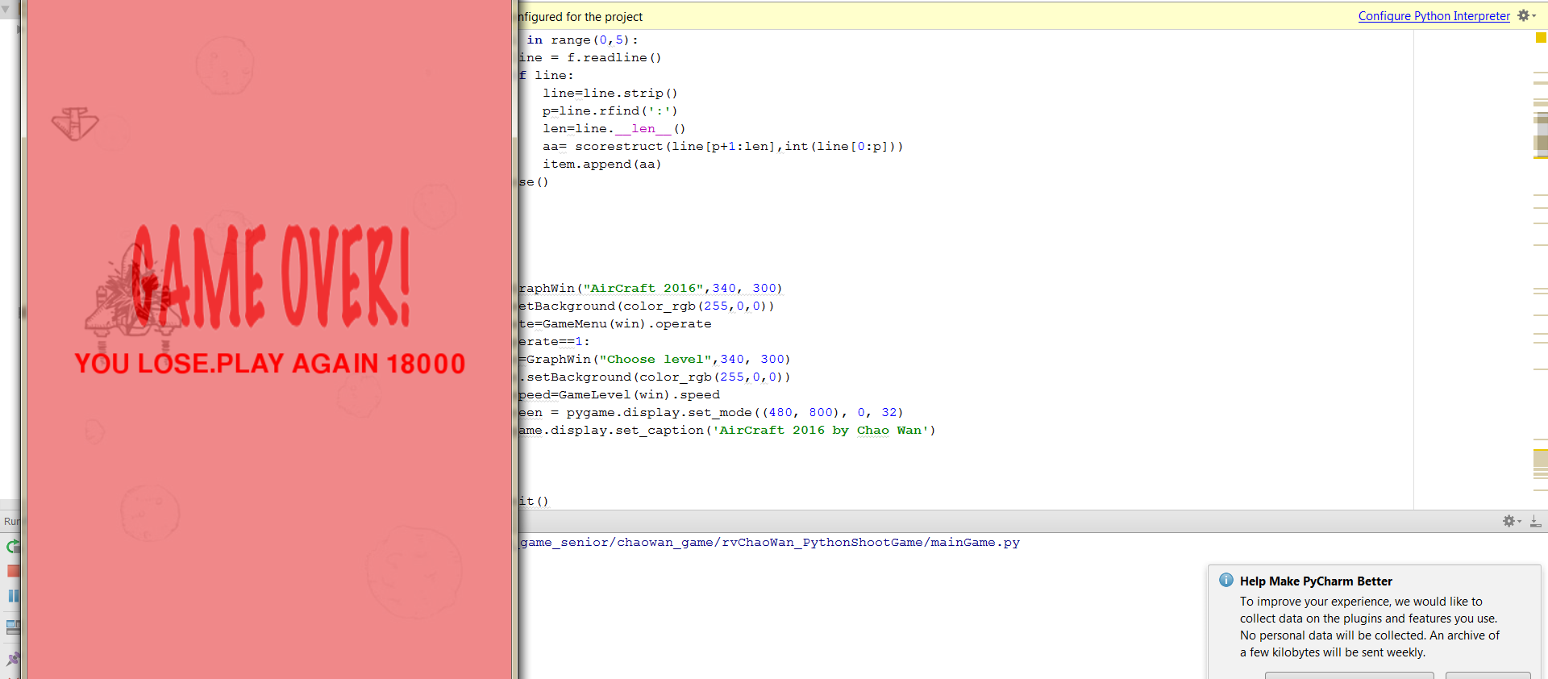
Game Over

